Slide 1
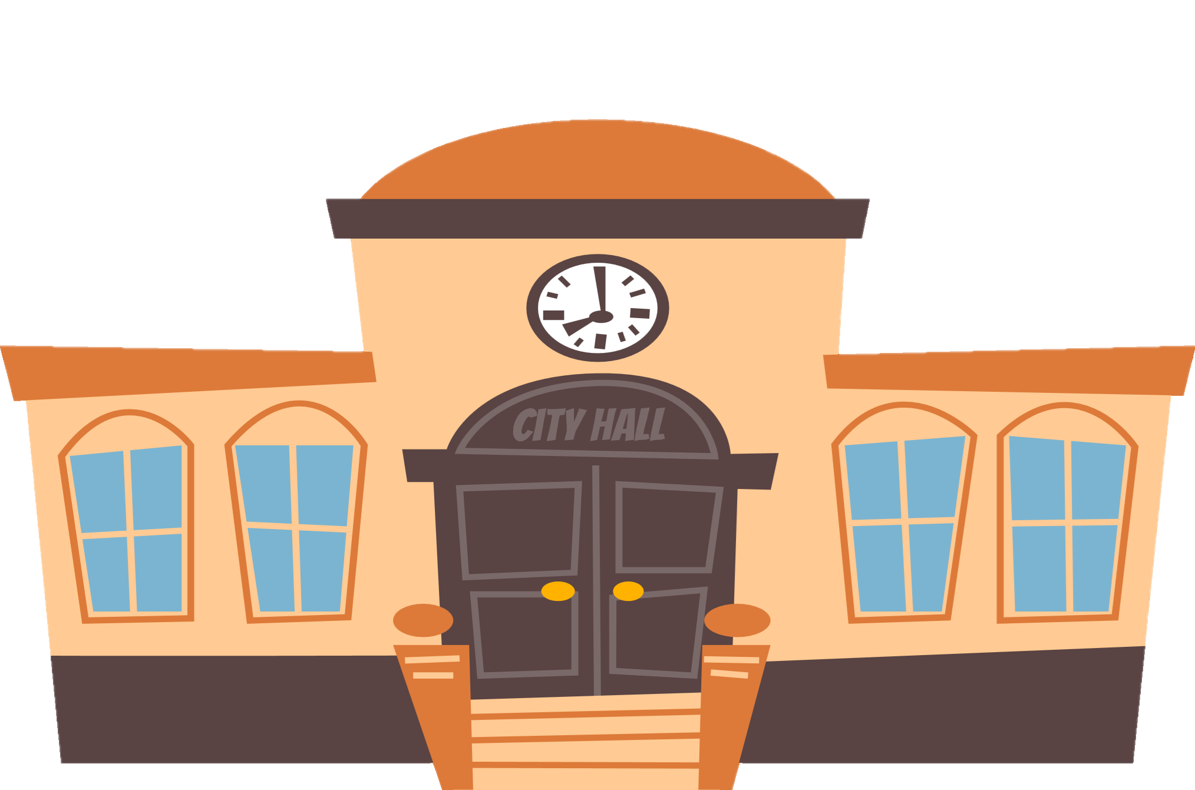
city hall

Slide 2
library

Slide 3
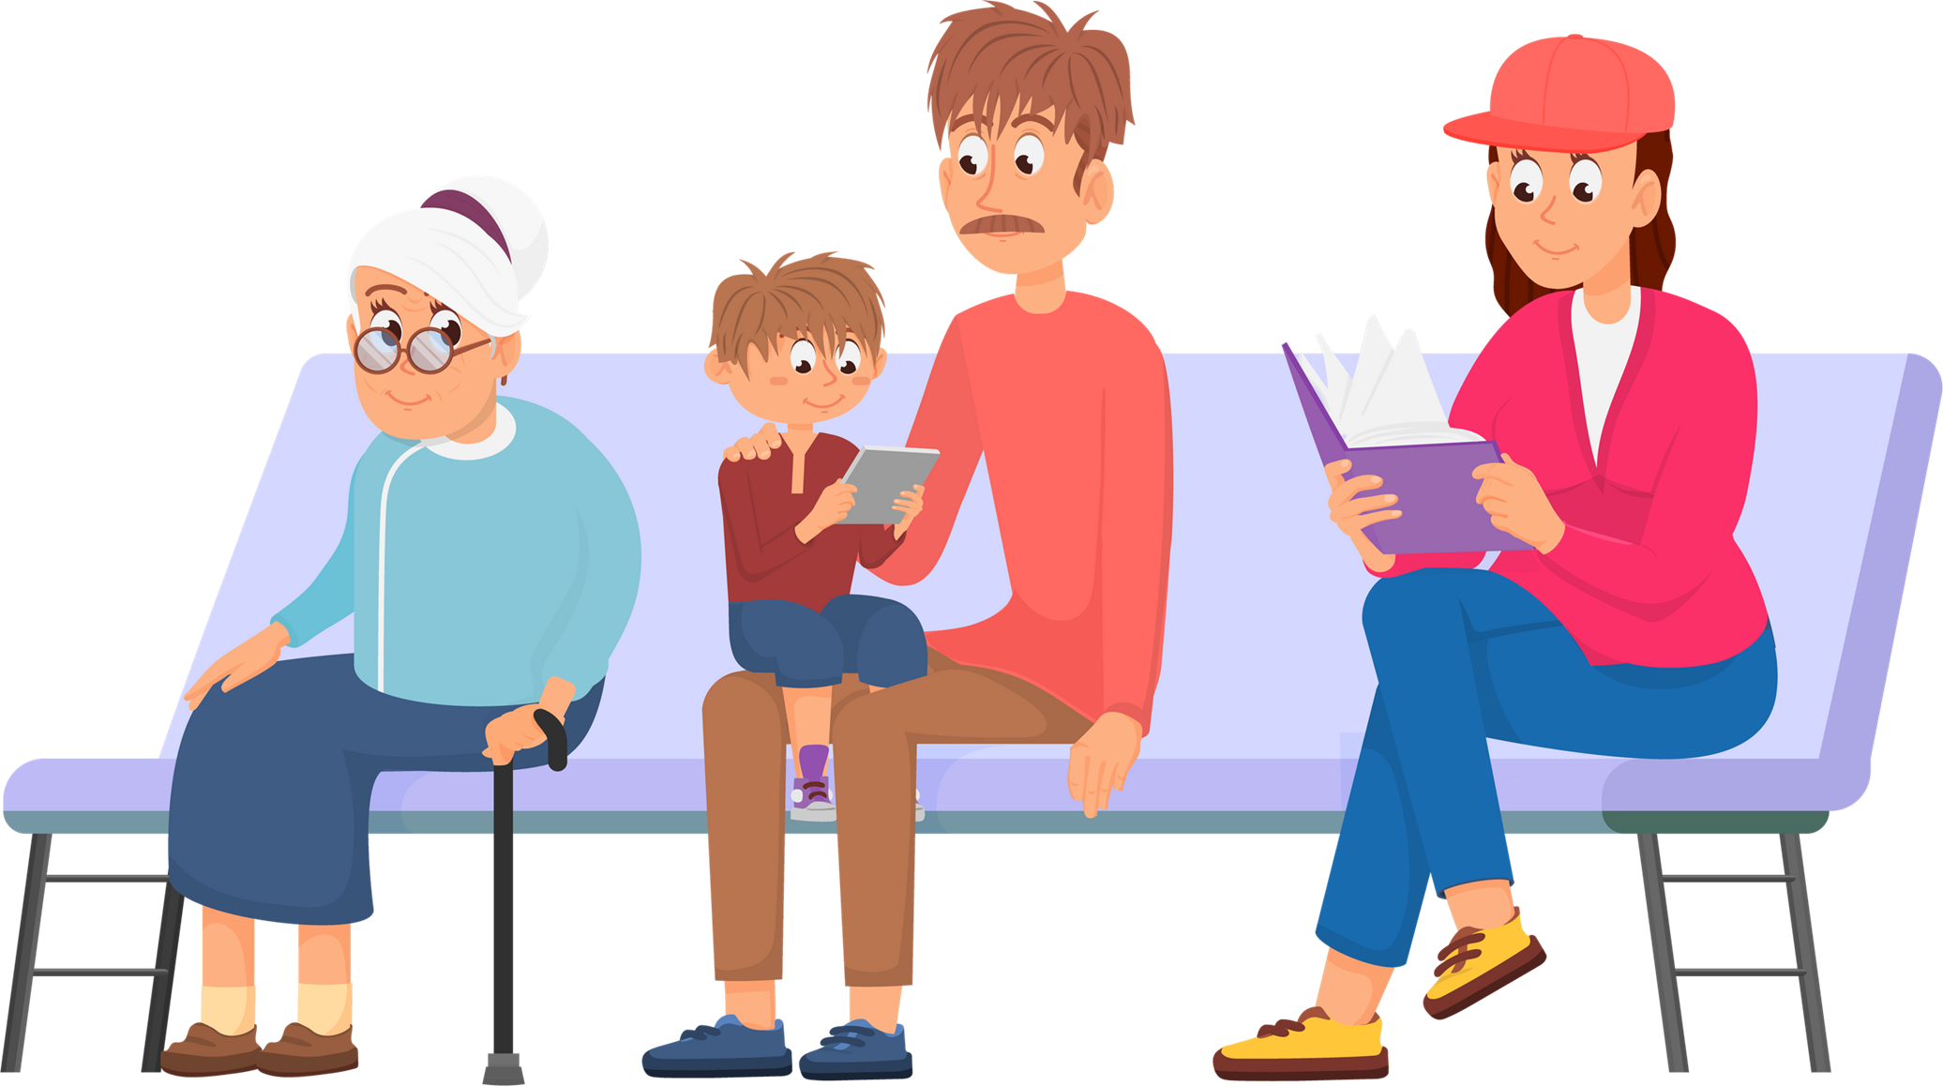
bus stop

Slide 4
station

Slide 5
music hall

Slide 6
police box

Slide 7
police station

Slide 8
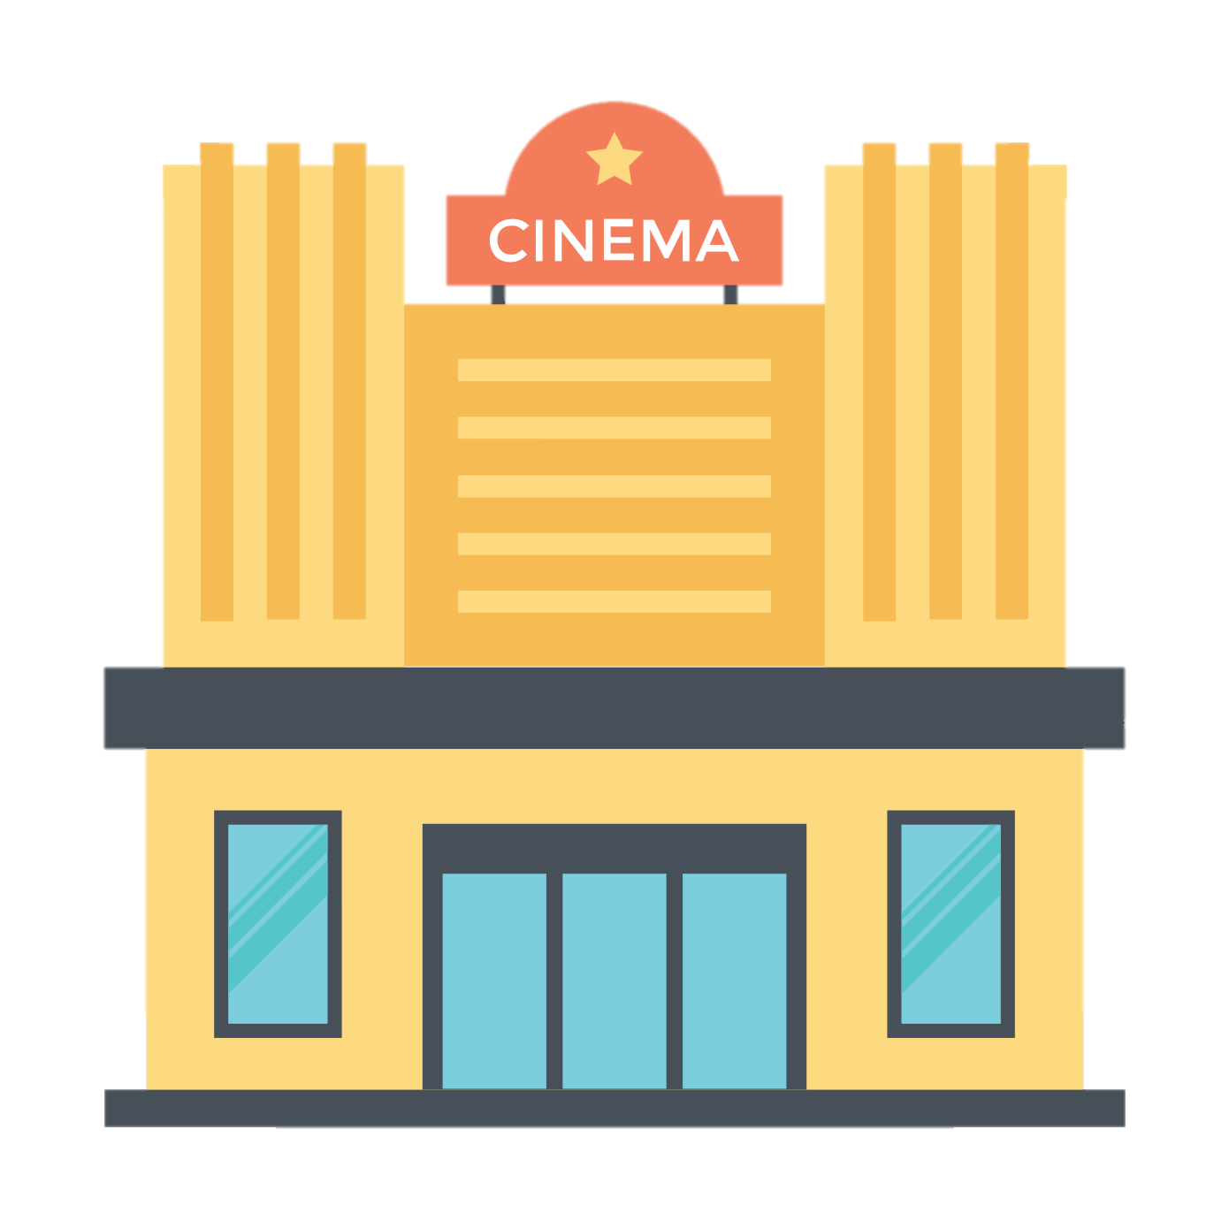
movie theater

Slide 9
museum

Slide 10
hospital

Slide 11
supermarket

Slide 12
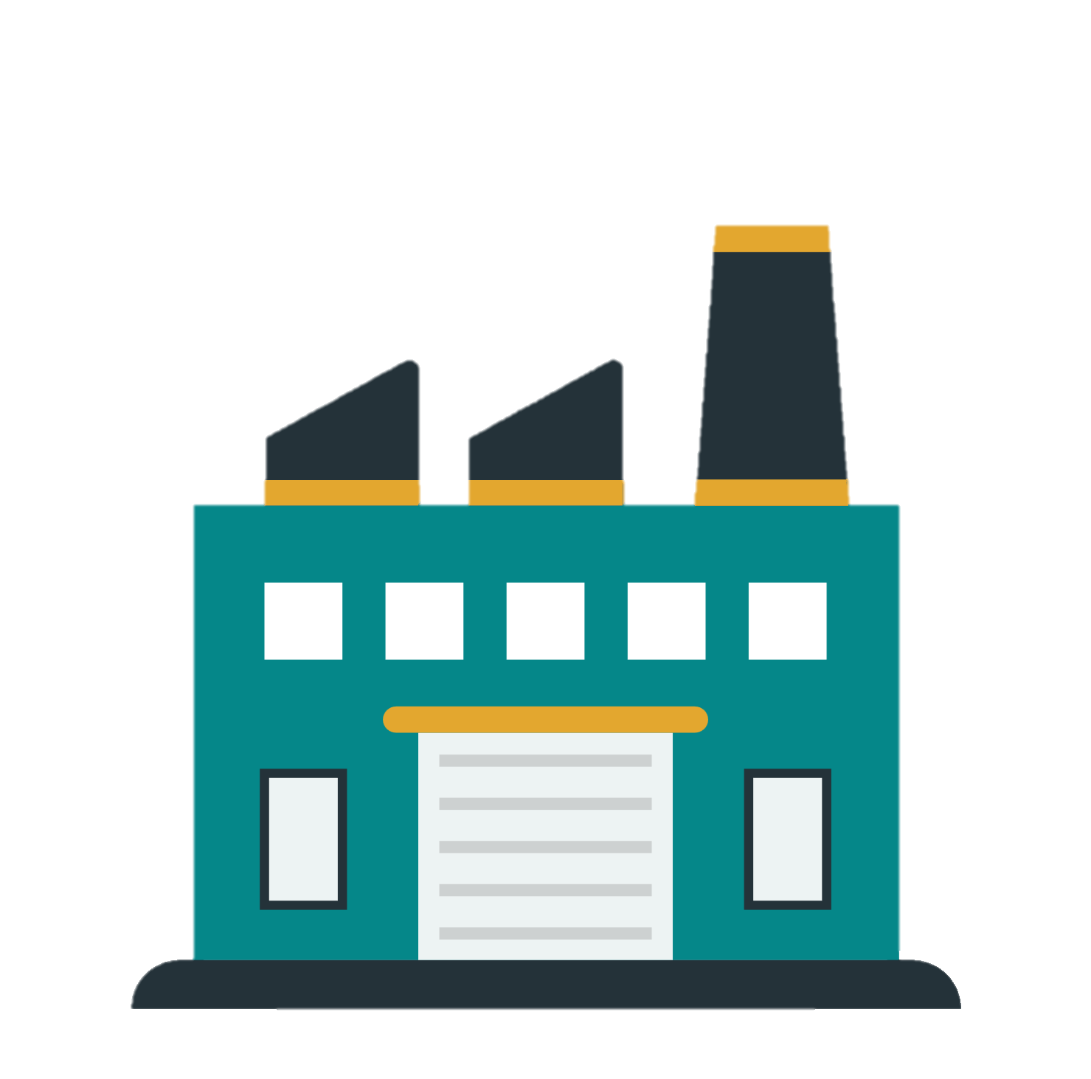
factory

Slide 13
post office

Slide 14
flower shop

Slide 15
park

Slide 16
bookstore

Slide 17
conveniece store

Slide 18
restaurant

Slide 19
shopping mall

