Slide 1



preview
Quiz:
What is My Job?

Slide 2
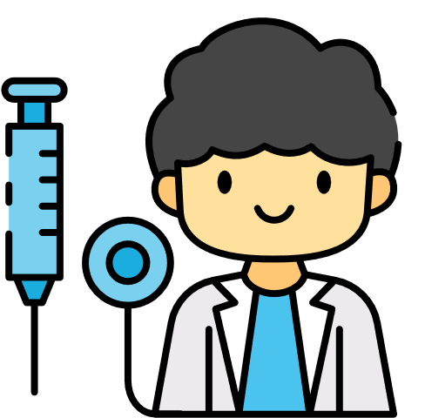
preview
  I help sick people.
  I work at a hospital.
  I wear a white coat.
doctor

Slide 3
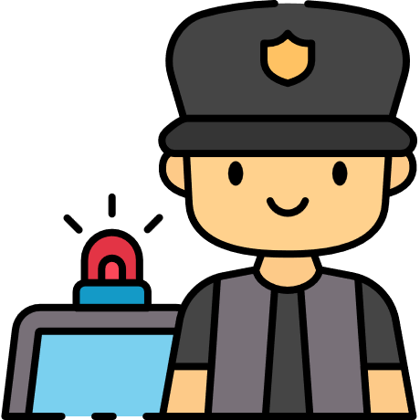
preview
  I work for the town.
  I keep the town safe.
  I drive a car to patrol.
police officer

